Slide 1
HoopFinder
Final Presentation
Iteration 5
Duoyao Zhang, Jamie Smart, Mike Zhong, Saloni Rawat, Sriram Ramdoss

Slide 2
Hoopfinder
Introduction to HoopFinder
Helps to facilitate organization and involvement in pick-up sports amongst strangers, specifically basketball
The application maps out basketball courts (or baseball, soccer, etc...) and uses user location services to identify when a user is "near" a court.

Slide 3
Functional Requirements:
A user should be able to create an account and login
A user can be able to subscribe court and subscribe other user
Google play services API is used to return user location information either as a response on a set interval
A user should be able to get push notification when another user is inside the court for greater than certain time interval (Note: Both the user should be subscribed to the same court)
A user can be able to add new court
Requirement Analysis

Slide 4
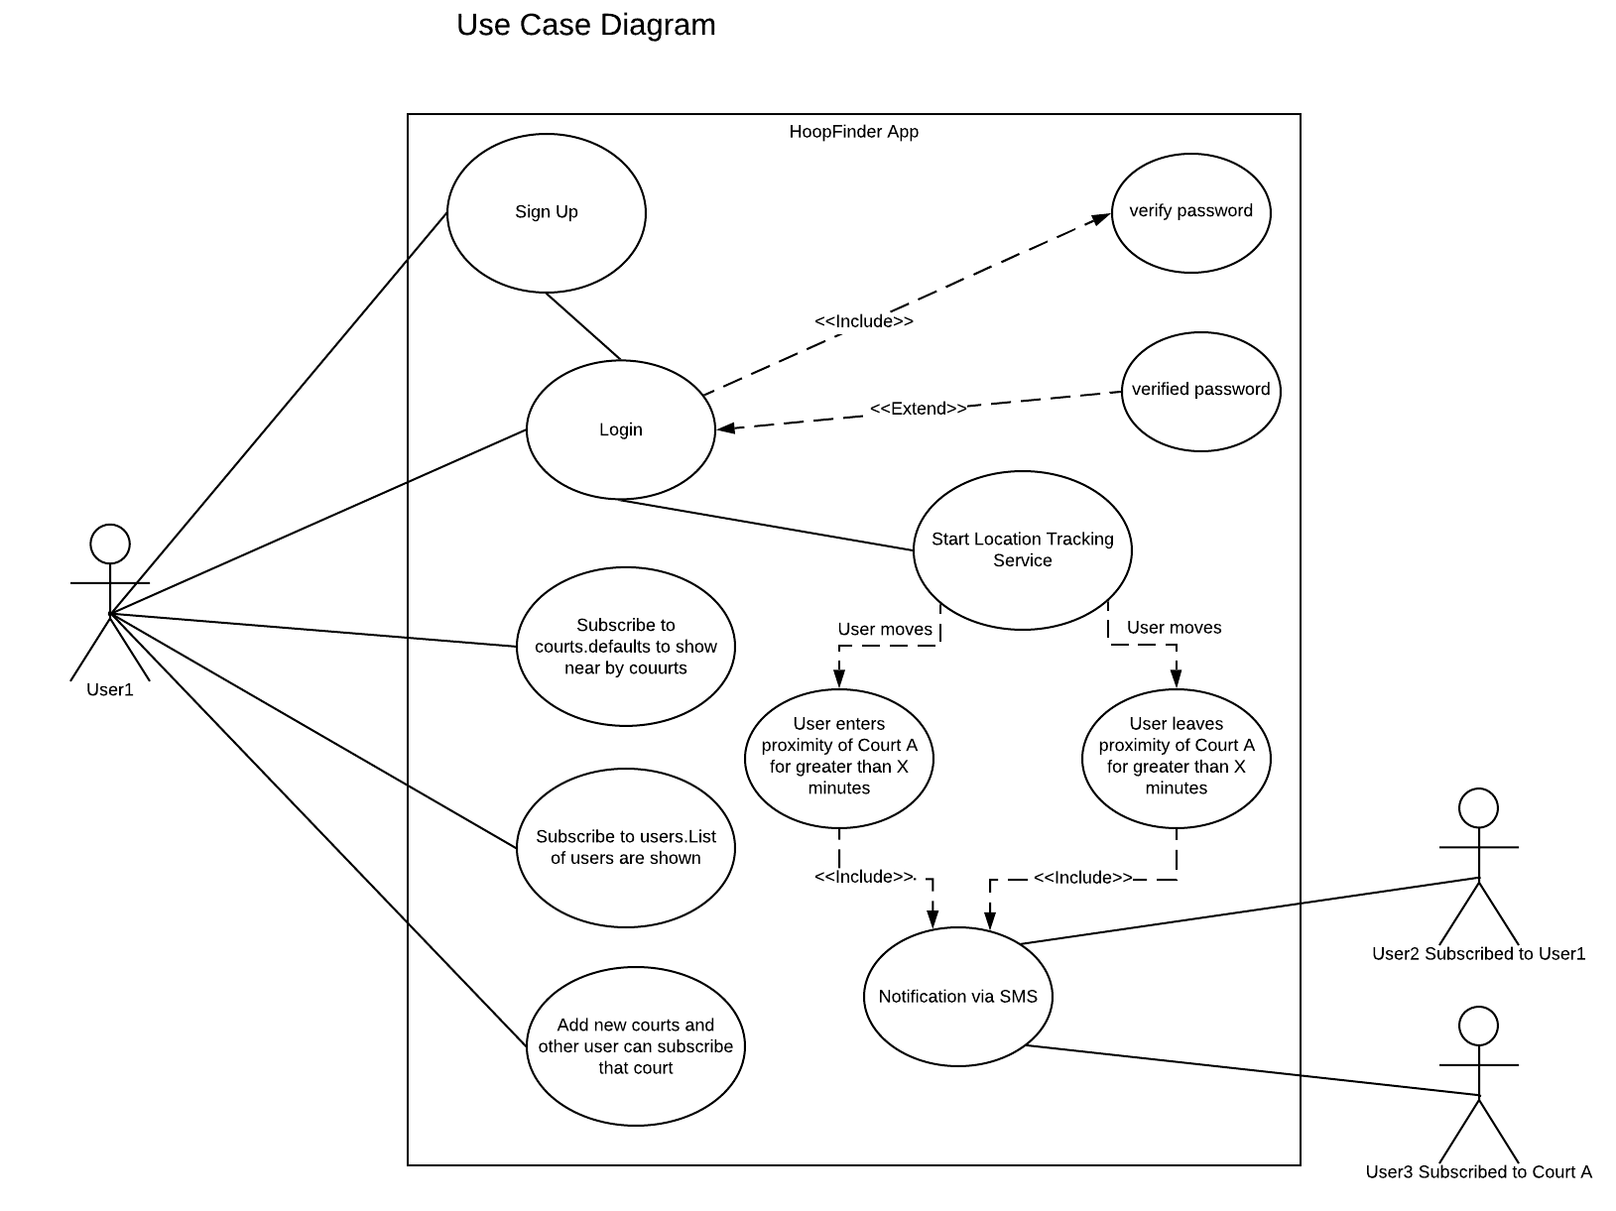
Use Case Diagram
Requirement Analysis

Slide 5
Non-Functional Requirements
Performance
For certain time interval (5 minutes) user location is checked and updated
Use-ability
User can be able to understand the flow of HoopFinder easily without any guideline
Reliability
User should give permission to access location and SMS notification on HoopFinder
Security
Firebase authentication token is used for comparison and security purpose
Requirement Analysis

Slide 6
Completed user stories:
Sign up in HoopFinder
User can create new account by entering Email and Password
Sign in into HoopFinder
User can be able to sign in into HoopFinder by giving valid username and password
Subscribe to courts
User can be able to subscribe to courts in HoopFinder
Receive Notification
User can be able to receive push notifications when another user is near a court they have subscribed to
User Stories

Slide 7
Completed user stories(contd..):
Add and View Courts
User can be able to add new courts which is not existing in HoopFinder
User can be able to view all the courts registered in HoopFinder
Sign Out from HoopFinder
User can able to sign out from HoopFinder
User Stories

Slide 8



Platform
User
user_id user_email user_pwd phone_number courtsSubscribedTo usersSubscribedTo
Court
name latitude longitude usersAtCourt

Slide 9
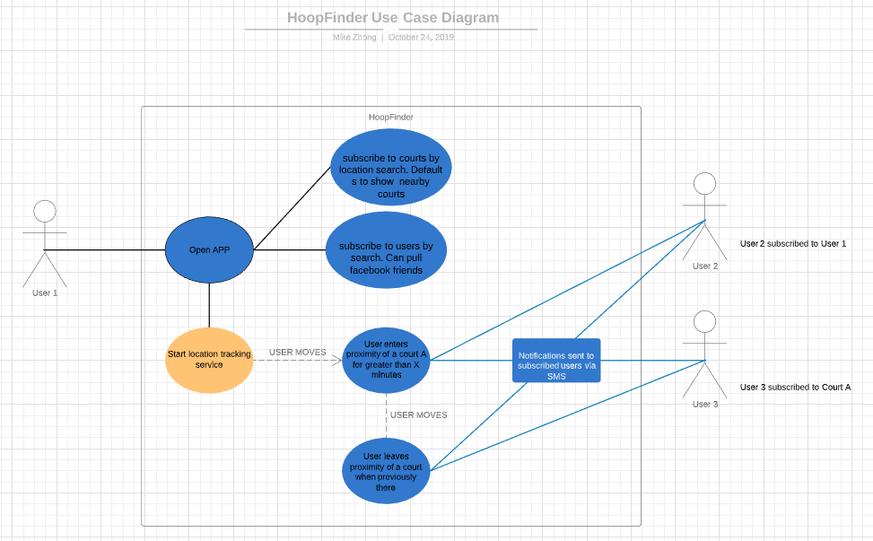
Design

Slide 10
Implementation
We utilize the Observer/Observable pattern for all of our views.
The asynchronous nature of reading data from the Firebase real-time database means we need to have several references to the DB at any given time, where each one has a listener pointing to a node, observing changes (additions, modifications, deletions, etc…)
Subscribe to Users:
List view utilizes adaptor items for each user.
Two DB refs used, one to read all users, the other to read the current users “userSubscribedTo” node
“updateUI()” is called in the listener which will produce an adaptor item for each user with a sub/unsub button based on their subscription status relative to the current user
Add Court:
Map view with markers for each existing court
One DB ref used, listens to the Court node and retrieves all courts
“updateUI” makes a marker for each court and places on map
On touch, a distinct marker type will appear -> on button press, user is prompted to enter the name of the new court and it gets written to DB

Slide 11
Implementation
Subscribe to Court:
Map view with markers for each existing court. The type of map marker indicates whether or not the current user is subscribed to that court
Two DB refs used, one to read all courts and one to read the “courtsSubscribedTo” field of the current user
All courts are rendered on the map as markers but the map marker will change based on the status (subscribed or not) of the current user.
If a current user touches a marker -> hit subscribe, that will update the current user’s “courtsSubscribedTo” field and the marker will need to be rendered differently to reflect its status update
New courts that get added will also trigger the UI to display new markers as new courts
Proximity Notification:
Proximity notifications are implemented as a background service and observe the “Court” table and “User” table
No UI, therefore no UI updates
When the current user has been in proximity of any court for the required time, current user is added to the “usersAtCourt” at the given court
Service is always listening to the “usersAtCourt” field of the “Court” table objects
Changes to that field will trigger notifications to be sent to all users who are subscribed to the given court (reading the “courtsSubscribedTo” field of each user and checking for the given court) and users who subscribe to the current user (reading the “usersSubscribedTo” field of each user and checking for current user)

Slide 12
Quality Assurance

Slide 13
Quality Assurance
Plan:
Track key metrics (elaborated later) ✔
Code standards ✔/x
Camel case for method names
Capitalize first letter of each word in a class name
Generate java doc comments as useful
Class files should contain a comment description in the header and other comments about the content of the file as useful/needed
Review ✔
All java class files to be peer reviewed before merging with dev branch
Work will be done on individual branches, when work is ready for merge, the author will initiate a pull request with the code’s intended purpose and any additional things the reviewer should be aware of/check for
Reviews will be assigned to one person as needed based on team availability
Any needed changes will be corrected by original author before pull request is accepted by reviewer and writer merges change into dev branch

Slide 14
Quality Assurance
Plan (continued):
Unit Tests ✔/x
10+ unit tests per class
Integration Tests: ✔/x
Perform 2 tests for each method in a class that interacts with a method or object in another class
Functional Tests: ✔
Performed ad hoc during development to test functionalities currently under development
Non-functional Tests:
Usability ✔/x
measure number of clicks to get to various activities
test GUI display on different devices
gather non-developer ratings on ease of app use
Security ✔/x
Test password acceptance and storage
Test for possibility of injection attacks

Slide 15
Testing
Test case examples:
Court Name Formatted Correctly
Subscribe to Court
App Service Knows Current Location
Passwords Must Match
Test pass rate: 24/30

Slide 16
Security

Slide 17
Android Security
Kernel level security
OS level(Linux kernel security)
Linux User Security Features
Filesystem Encryption
Password Protection
App level security
Use permissions
User Authentication
API security
Database security

Slide 18
App permission and our practice
Tenets of working with Android permissions
Only use the permissions necessary for your app to work.
Pay attention to permissions required by libraries.
Be transparent.
Make system accesses explicit.
android:protectionLevel
<uses-permission android:name="android.permission.ACCESS_FINE_LOCATION" />
<uses-permission android:name="android.permission.ACCESS_COARSE_LOCATION" />
<uses-permission android:name="android.permission.INTERNET" />
Notes:
Permission requests protect sensitive information available from a device and should only be used when access to information is necessary for the functioning of your app. This document provides tips on ways you might be able to achieve the same (or better) functionality without requiring access to such information; it is not an exhaustive discussion of how permissions work in the Android operating system.

Slide 19
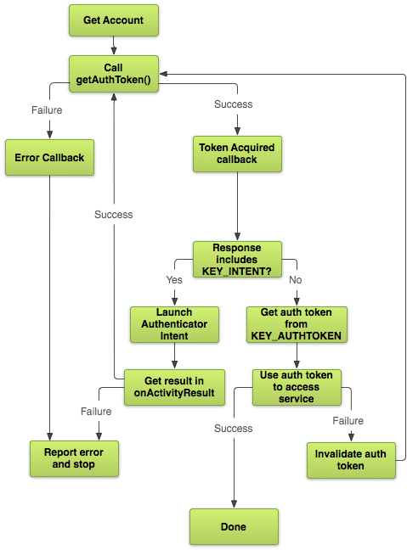
User authentication
User input validation(SQL injection)
UID
Token
Security rules
service firebase.storage {
match /b/{bucket}/o {
match /{allPaths=**} {
allow read, write: if request.auth != null;
}
}
}
Notes:
Knowing who your users are is an important part of building an application, and Firebase Authentication provides an easy to use, secure, client side only solution to authentication. Firebase Security Rules for Cloud Storage ties in to Firebase Authentication for user based security. When a user is authenticated with Firebase Authentication, the request.auth variable in Storage Security Rules becomes an object that contains the user's unique ID (request.auth.uid) and all other user information in the token (request.auth.token). When the user is not authenticated, request.auth is null. This allows you to securely control data access on a per-user basis.

Slide 20
API Key security
Do not embed API keys directly in code. ✔
Do not store API keys in files inside your application's source tree.
Set up application and API key restrictions.✔
Delete unneeded API keys to minimize exposure to attacks.✔
Regenerate your API keys periodically.

Slide 21

Project Management

Slide 22
Role Assignment
Team Member | Roles
Mike Zhong | Design and Implementation Leader Backup Team Lead
Sriram Doss | Requirements Leader
Jamie Smart | QA Leader
Douyao Zhang | Security Leader
Saloni Rawat | Configuration Leader, Team Lead
Notes:
In terms of role assignment oh no

Slide 23
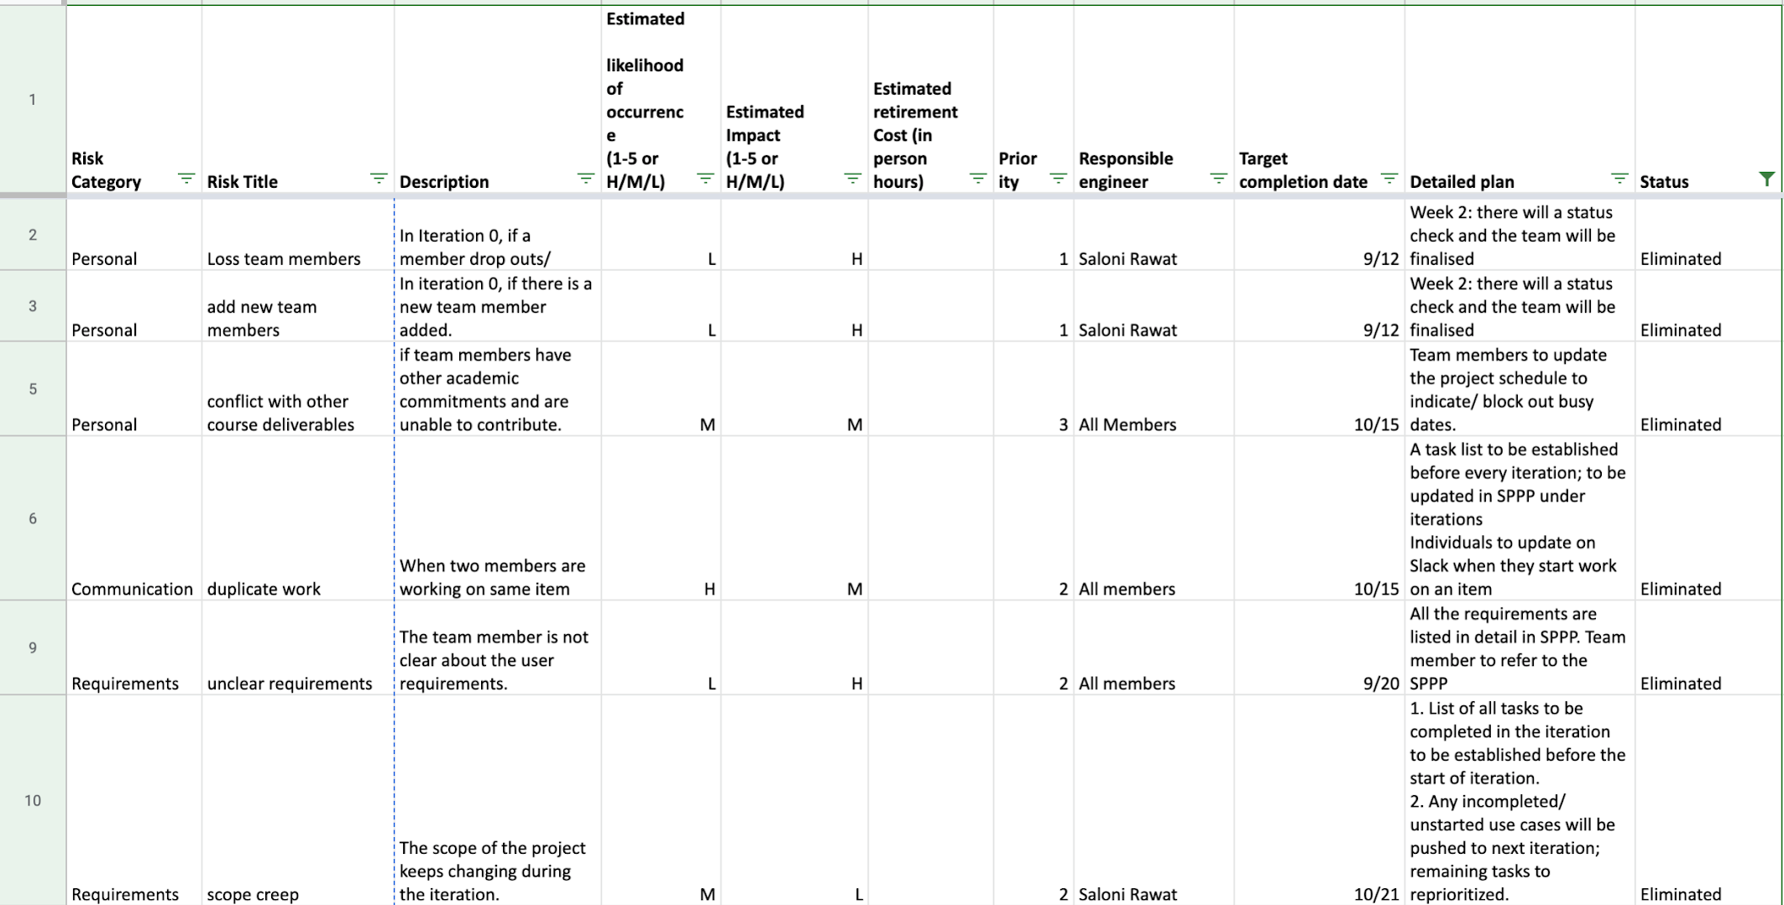
Risk Management
The full metrics is available on - https://docs.google.com/spreadsheets/d/1BsizjOC6WBk_iK5iA5BvmczAlPb2INCN/edit#gid=436921088

Slide 24
Metrics
 | 0 | 1 | 2 | 3 | 4 | 5
# hours worked | 14 | 32 | 45 | 30 | 34 | 42*
# defects | 0 | 0 | 2 | 2 | 4 | 5
# lines of code | 0 | 34 | 479 | 675 | 2033 | 3565
# user stories added | 0 | 1 | 2 | 1 | 3 | 1
# class files | 0 | 3 | 6 | 7 | 15 | 18

Slide 25
Iteration Evaluation
Iteration # | Tasks Planned | Completed items | Pushed to next iteration | Major issues
0 | ●Identify the project ●Confirm project roles ●Define basic requirements | All tasks were completed on time. | N/A | The team was unfamiliar with Android development
1 | ●Define more technical requirement ●Build a basic app with login, view location of a court, and sent notifications. | -Able to fetch user’s current notification | WIP:facebook/email login. -Push/text notifications -DB connection | Issues with SQLlite, and integrating facebook login Decided to drop custom email login because of security issues
2 | ●Text/push notifications to user ●Store user data on firebase ●Create location table in firebase | - facebook login completed. - user data stored on database - court location table created - text messages enabled. | WIP: Storing user data and location data on firebase | -Retrieving phone number from facebook login

Slide 26
Iteration Evaluation
Iteration # | Tasks Planned | Completed items | Pushed to next iteration | Major issues
3 | ●Store user location data ●Add new courts ●View user and court information ●Create a user subscriber relation | - add and manage courts info on DB - user subscriber table created - UI for the displaying user and courts info - display courts on map view | N/A | Because of limited fb functionality, the team decided to implement custom Login.
4 | ●login using Firebase Authentication ●View nearby courts ●View user information ●Perform end to end testing | -User can register for app -User can sign in to app -User can sign out of app -User can receive push notifications when another user is near a court they have subscribed to -User can add and view courts | WIP: Display all user info to be able to subscribe | Difficulties pulling data from the database and displaying to the UI
5 | ●Subscribe to courts and users ●Fix pending bugs | - User can subscribe to courts and users.

Slide 27
Achievements
Build an android application with firebase database
Able to deliver most of the functionalities as planned.
Implemented Map view to add and subscribe to courts
Effective use of Github

Slide 28
Challenges and lessons learned
First time working with android and firebase database
Thorough research along with practice is best strategy
Collaborate and learn from other members
Difficulties integrating everyone’s work
Effective communication and use of github
Members to make minimum changes on other’s work to avoid conflicts
Merges to master only when the whole team is present to validate
Group coding sessions to avoid overlap
Staying on track during iterations
Clear understanding of the tasks at hand.
Attend to urgent issues first which are blocking other functionalities.
Clear communication from team members

Slide 29
Demo

Slide 30


